Slide 1
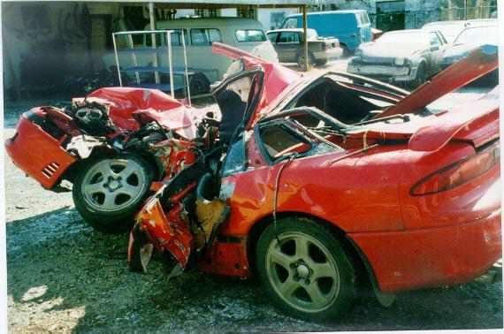
Traumatic Brain Injury (TBI)

Slide 2
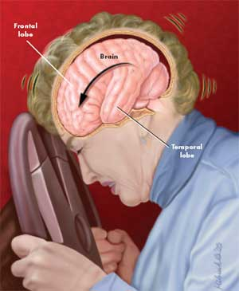
Definition
TBI is alteration in brain function (not degenerative or congenital) that is caused by an external physical force.
Often causing impairment of:
Cognitive
Perceptual
Emotional
Behavioral
Physical functioning.

Slide 3
Definition
Alteration in brain function is determined by :
Loss of or decrease in the level of consciousness
Any Loss of memory for event (before/after) injury (PTA)
A neurological deficits( sensory or motor loss, balance,vision…)
Any change in mental state at the time of injury (confusion, disorientation….
Neuroradiologic or laboratory evidence of brain damage.

Slide 4
Incidence, Prevalence, Causation
Approximately 1.7 million people in the US sustain a TBI
Population of TBI is typically:
children 0–4 years > older adolescents 15–19
Also persons 75+
Male > Female
Causes:
Falls
motor vehicle accident (MVA)
Interpersonal violence
Alcohol use (50% of people who sustain TBI were intoxicated at the time of injury and have a longer morbidity outcomes: longer hospitalization, agitation, lower cognitive status at discharge)

Slide 5
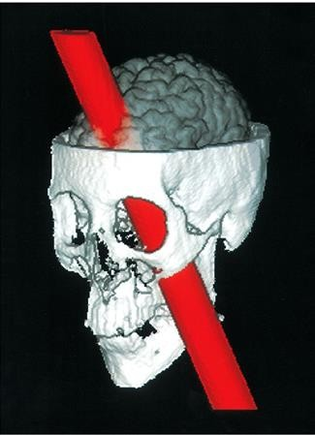
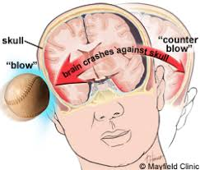
Classification of TBI
1. Open head injury
Penetration of the head
Enter the cranial cavity
Common causes: severe fall, gunshot, assault, vehicle accident
2. Closed head injury
No open head wound; brain damaged internally
Could be:
Dynamic : acceleration and deceleration
Static : crush injury
Common causes: Falls, vehicle accidents, sports accidents

Slide 6
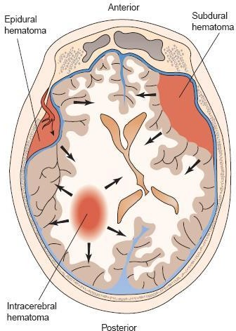
Classification of TBI (Extent of Pathology)
Focal Injury
Contusions and lacerations of the brain
Occur when the brain hits the skull
concentrated in a particular area
With or without skull fractures
Hematoma
Mass of blood confined to an organ or space
Caused by a broken blood vessel

Slide 8
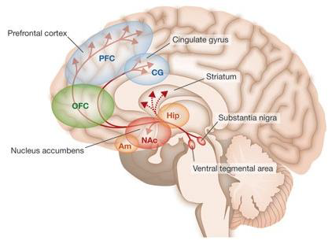
Focal Lesions
Occipital and parietal lobes are less likely to damage
Impairments may include:
Usually Prefrontal & anterior temporal areas
Interrupts connections to subcortical limbs structures
» Memory
» Emotion
» Drive
Orbitofrontal areas
Extreme impulsivity
No motor or speech impairments

Slide 9
Focal Lesions
Impairments may include:
Frontolateral area
Hemiparesis
Impulsivity
Attentional impairments
Decreased accuracy and mental flexibility

Slide 10
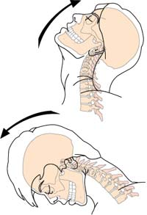
Diffuse Brain Injury
Injury is not pinpointable
Usually from closed head sudden rotational deceleration. (e.g. Head hitting the airbag)

Slide 11
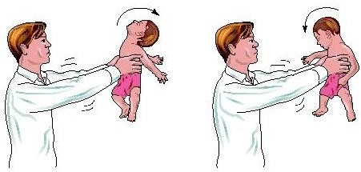
Diffuse vs. Focal injuries
DIFFUSE LESIONS
Traumatic axonal injuries= Diffuse axonal injuries
Common and devastating
Shearing injuries affecting long axonal tracts
Acceleration
Deceleration
Rotation
Brainstem is more stable than the cerebrum (rotates around brainstem)
Rotation = stretch or shear force on the long axons that transmit information throughout the brain and brainstem =

Slide 12
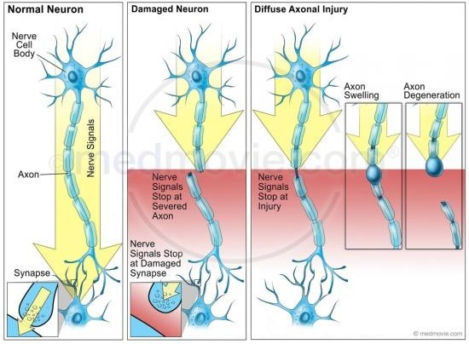

Slide 13
Diffuse axonal injury

Slide 14
Diffuse axonal injuries
Results in coma
If the axonal injury was mild → coma reverse quickly
If axons were ruptured→ vegetative
Recovery from coma → progresses to a period of confusion with impaired attention and PTA.
WHAT IS THE PTA?

Slide 15
Diffuse axonal injuries
When confusion clears → cognitive impairments are evident
Reduced mental processing speed & efficiency
Difficulty with divided –attention tasks
Difficulties in higher-level functions (abstract reasoning, planning, problem solving )
Behavioral problems

Slide 16
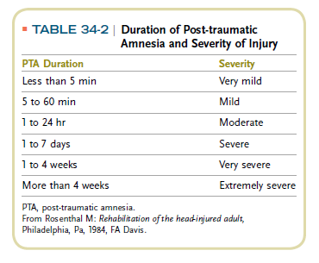

Slide 17
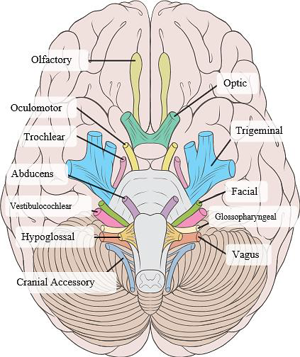
Cranial Nerve Damage
Can be:
torn
stretched
contused
Olfactory (I) is often torn when frontal
lobes is affected
Optic (II)
Oculomotor (III), Trochlear (IV), Abducens (VI) = eye movement: vulnerable

Slide 20
Symptoms
• Varies from mild to profound
• May be permanent or temporary
• Symptoms may appear immediately or over weeks, months, years

Slide 21
Severity
Mild
Initial Glasgow coma Scale score of 13-15
Trauma-induced physiological disruption of brain functions, disoriented, confused
loss of consciousness for 15 minutes to few hours
Named concussion
Moderate
Initial Glasgow coma Scale score of 9-12
Loss of consciousness greater than 30 minutes
Severe
Initial Glasgow coma Scale score of 3-8
loss of consciousness longer than 6 hours

Slide 22
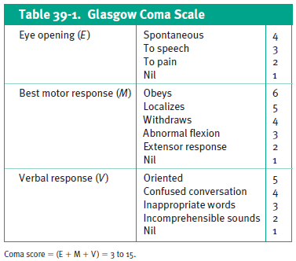
Phases TBI survivors Medical treatment
The GCS provides an objective assessment of moderate to severe TBI using a 15-point system to test motor, eye-opening, and verbal capabilities (video)

Slide 23
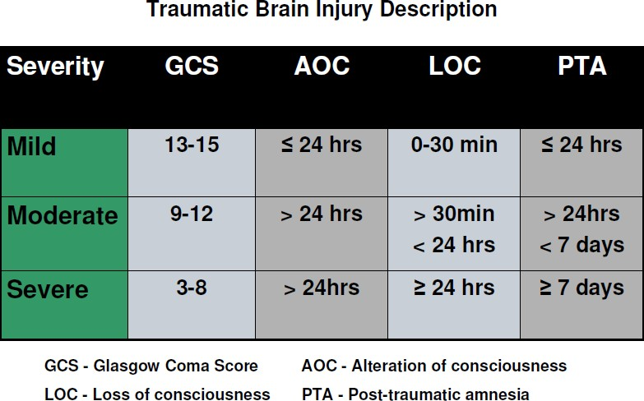

Slide 24
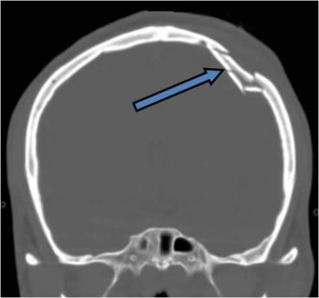
Primary Brain Damage
Damage that is complete at the time of impact may include:
Skull fracture: breaking of the bony skull
Hematomas/blood clots: occur between the skull and the brain or inside the brain itself
Lacerations: tearing of the frontal (front) and temporal (on the side) lobes or blood vessels of the brain
Contusion
Nerve damage (Trumatic axonal injury): arises from a cutting, or shearing, force from the blow that damages nerve cells in the brain's connecting nerve fibers

Slide 25
Secondary Brain Damage
Cerebral Edema
Intracranial Hemorrhage
Ischemic Brain Damage
Brainstem Compression
General Systemic Reactions to Neural Impairment
Electrolyte Abnormalities
Altered Respiratory Regulation
Intracranial Infection
Abnormal Autonomic Nervous System Responses

Slide 26
Phases TBI survivors
Four phases of life for the adult survivor of moderate to severe TBI:
Pre-injury
Medical treatment
Rehabilitation
Survivorship

Slide 27
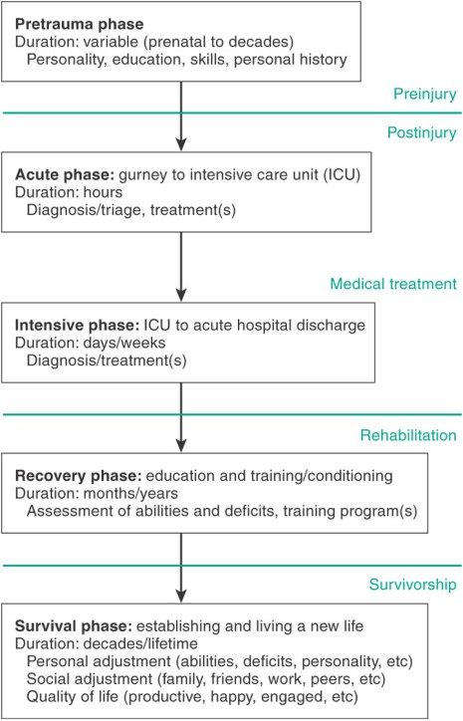
Four Phases of Life for the Survivor of TBI

Slide 28
Phases TBI survivors Pre-injury
Individualized
Understanding pre-morbid factors that may affect the patient’s recovery.
pre-existing neurological conditions, such as previous TBI, epilepsy, dementia, or stroke.
Background prior to TBI
Personal
Social
Cultural

Slide 29
Phases TBI survivors Medical treatment
Emergency Medical Treatment
Protection of the airway
Adequacy of breathing and blood pressure,
Vital signs,
Heart rate
Usually immobilize the patient on a rigid backboard with the neck in a rigid cervical spine collar
A general assessment of injuries and neurological status
(The Glasgow Coma Scale)
Alcohol/drug intoxication may prevent accurate neurological exam in the ER

Slide 30
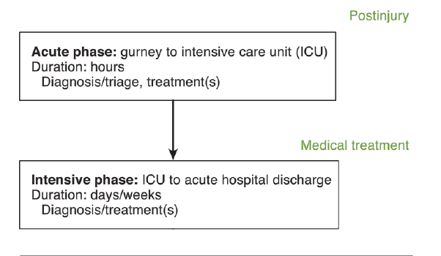

Slide 31
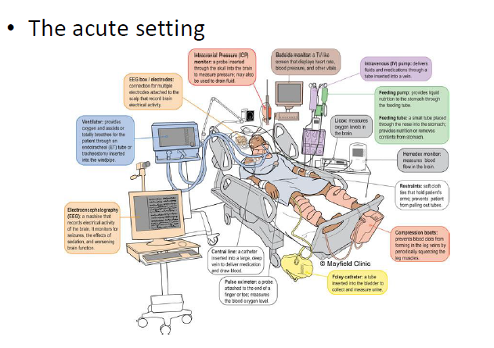

Slide 32
Phases TBI survivors Medical treatment
GCS of 8 or less predicts :
50% mortality
survive with moderate to severe disabilities
Computed tomography (CT) of the head is usually obtained within 30 minutes to determine the presence of intracranial hematomas or contusions.
With the exception of small lesions in patients with stable neurological signs, hematomas must be surgically evacuated as soon as possible to optimize chances for survival and recovery.

Slide 33
Phases TBI survivors Medical treatment
Intensive Medical Management
Optimize cerebral perfusion and brain tissue oxygenation
Minimize brain swelling
Length of stay?
Maintain all other physiological variables within the normal range
Referral to rehab (OT)

Slide 34
Patients with Severe Alterations in Consciousness
A person with TBI may exhibit any of a number of altered states of consciousness, depending on the severity of the injury

Slide 35
Alteration in Consciousness - Severity
Coma:
Unarousability with absence of sleep & loss of interaction with the environment
Patient’s eyes do not open either spontaneously or to external stimulation.
does not follow commands.
does not mouth or speak recognizable words.
does not demonstrate intentional movement (may show reflexive movement such as posturing, withdrawal from pain, or involuntary smiling).
cannot sustain visual pursuits through a 45° arc in any direction when the eyes are held open manually.
These criteria cannot be attributed to use of paralytic agents.

Slide 36
Alteration in Consciousness - Severity
Vegetative:
Complete unawareness with the self or the environment. Starts after a coma.
Sleep wake cycles
No sustained, reproducible, or voluntary behavioral responses to sensory stimuli
No language comprehension

Slide 37
Alteration in Consciousness - Severity
Minimally conscious state:
Patients no longer comatose or vegetative but are severely disabled (slow-to-recover).
Purposeful behaviors/responses after a specific command, question, or environmental prompt
Following simple commands
Gestural or verbal yes/no responses (regardless of accuracy)
Intelligible verbalization

Slide 38
Assessment
Rancho Los Amigos Levels of Cognitive Functioning Scale
First three levels describe the response to stimulation and the environment for people emerging from coma
Usually paired with Glascow Coma Scale
Behavior-based assessment measures

Slide 39
Outcomes and prognosis
Neuroimaging evidence?
Age?
Clinical observation.
Notes:
.

Slide 40
Clinical Picture
Physical Status
Cognitive Status
Perceptual Skills
Psychosocial Factors

Slide 41
Physical and Cognitive Changes
Hyperreflexia
Abnormal muscle tone
Hypertonia
Hypotonia
Ataxia
Spasticity
Sensory changes
Dysphagia
Activity tolerance
Vision
Memory
Attention
Distractibility
Initiation
Task requirement
Impulsivity
Abstract thinking
Behavioral status
All changes possible at any level of TBI severity

Slide 42
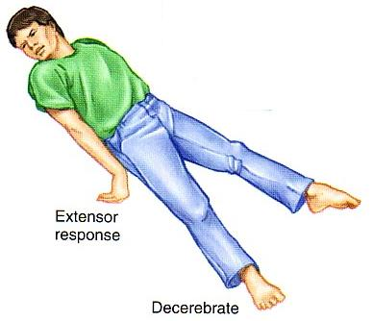
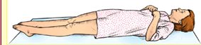
Rigidity
Decerebrate:
UE and LE in spastic extension, adducted,
internally rotated
Wrists pronated, fingers flexed
Ankles flexed and internally rotated
Decorticate:
UE in spastic flexion, adducted,
internally rotated
Wrist and fingers flexed
LE spastic extension,
feet plantar flexed

Slide 43
Interventions for patients in Severely Altered State
Goals:
Foster alertness and behavioral responsiveness
Prevent complications
Intervention:
PROM exercise
Positioning
Tone alteration
Family/caregiver support and education
Sensory stimulation (case by case)
Controversial
Limited evidence

Slide 44
Rehabilitation
Inpatient and outpatient: until goals are reached or patient plateaus
Optimizing motor, visual-perceptual, and cognitive skills
Contributing to the patient’s behavioral and emotional adaptation
Supporting the patient’s family in preparation for discharge

Slide 45
Survivorship
Survivors live with lasting consequences of TBI for years
Some independent with self-care tasks
Others require complete assistance
Residual Cognitive, behavioral, emotional issues
Community integration
Work, driving, previous life roles (although likely adapted)

Slide 46
Safety precautions with TBI patients
Control of Intracranial Pressure (ICP)
Observe for:
Pupil changes; decreased neurological responses; abnormal brainstem re exes; what else?
What to. Do?
Side-lying with the head of the bed elevated is the most desirable position.
Side-lying avoids the increased extensor tone promoted in supine
Prone lying is contraindicated with increased ICP and supported sitting at 90º is used as soon as tolerated to help breathing, provide symmetrical body alignment and to increase awareness of surroundings
Notes:
46

Slide 47
Safety precautions with TBI patients :
Epilepsy
Posttraumatic epilepsy occurs in 5% of patients with TBI and late onset epilepsy affects 20% of those with prolonged unconsciousness, depressed skull fracture, or intracranial hematoma
To reduce the chance of a seizure during treatment: begin tactile stimulation and range of motion slowly to asses the patients’ physiological response
Monitor the heart rate, blood pressure and facial color and any autonomic changes such as sudden perspiration or increased restlessness
Gradually increase intensity of stimulation
Seizure precautions: avoid rapid repetitive stimuli such as vibration, flickering lights, and fans
What to do when a seizure occurs: ensure open airways, position the patient on his or her side to prevent aspiration of stomach contents, summon medical assistance, patient’s limb should not be restrained during a seizure
Notes:
47

Slide 48
Safety precautions with TBI patients
3. Tear in dura
Cerebrospinal fluid may leak.
Maintain head elevation, antibiotics,
No nose blowing
Fractures (move slowly)
Avoid disturbing nasogastric tubes
Notes:
48

Slide 49
Mild TBI
Or Concussions…

